Slide 1
Movie Viewing Analysis
By Dola Ghosh

Slide 2
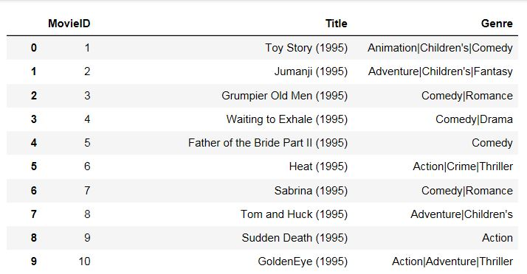
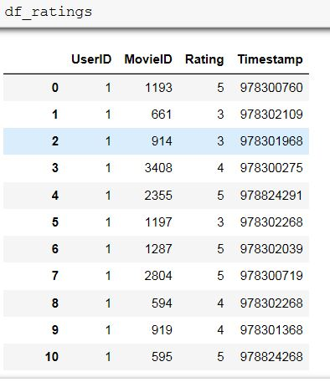
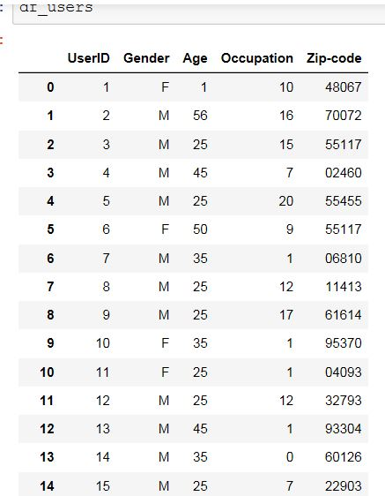
EDA of Movie, Rating &User Datasets

Slide 3
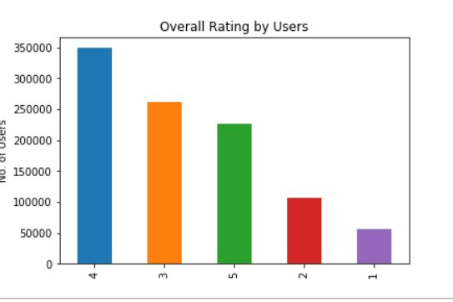
Overall Rating

Slide 4
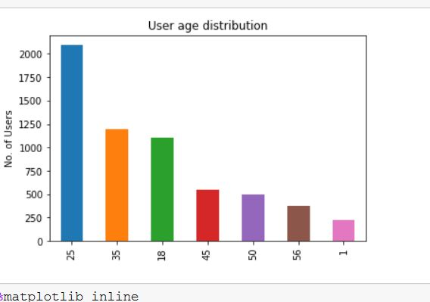
Viewers Age Distribution

Slide 5
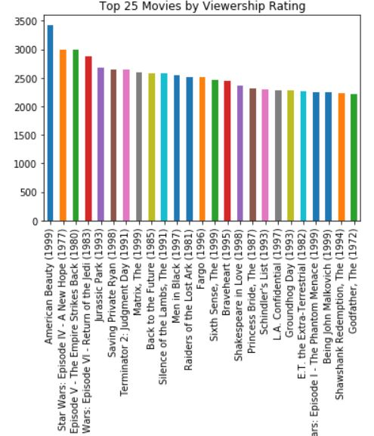
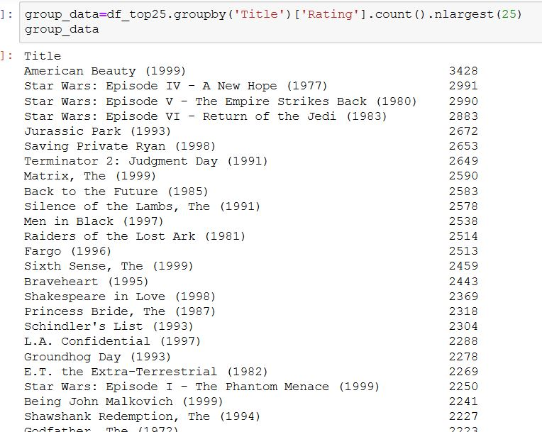
Top 25 Movies

Slide 6
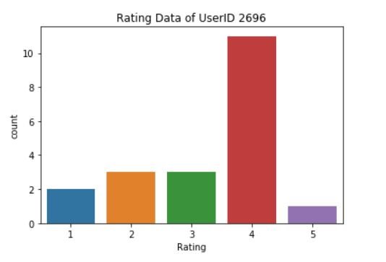
Rating By UserID “2696”

Slide 7
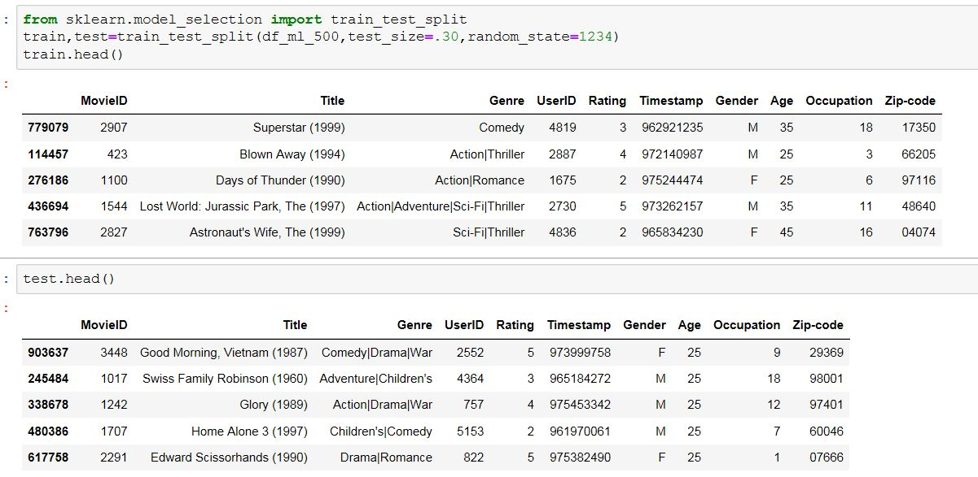
Train and Test Datasets

Slide 8
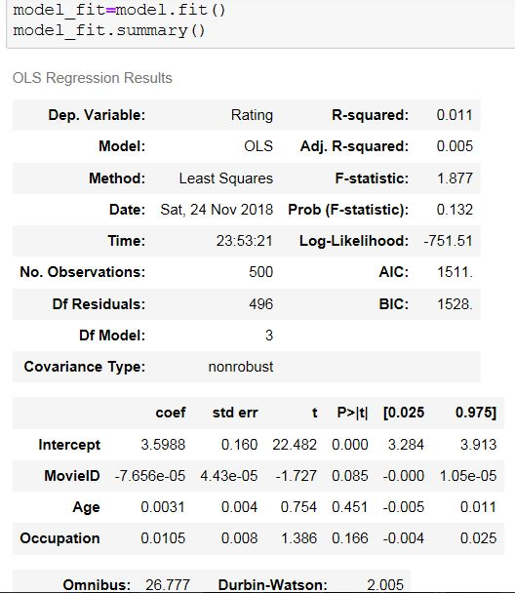
Linear Regression Model Summary

Slide 9
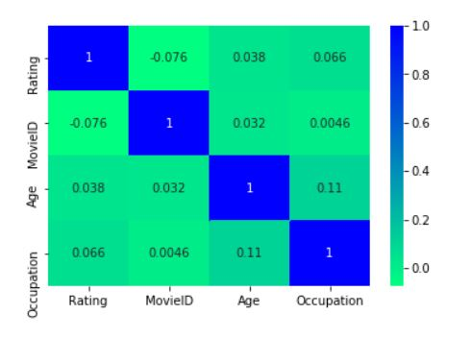
Heat Map to show Correlation

Slide 10
Thank You

